Slide 1

3 Overlooked Areas of Volunteers
Youth, Family, and Intergenerational

Slide 2


Youth Volunteering
Volunteer organizations rely on the availability of a pool of volunteers.
This pool is usually a very diverse group of people BUT has one concurrent theme:
*Their history of volunteering began early in childhood*
*A pattern of ingrained volunteering is likely to have become ingrained by the teenage years-- teens are 3 times more likely to volunteer than their counterparts who did not as children

Slide 3

Differences: Volunteering Makes Them!
Childhood volunteering sets in motion a pattern that is likely to remain strong throughout a lifetime
Volunteering youths were found to have experienced more psychological, social, and intellectual than non-volunteers
Young volunteers develop a more socially responsible perspective
Volunteering exposes children to real life examples of values-driven action

Slide 4

What does recruitment take?
The importance of recruiting youthful volunteers cannot be understated, BUT…
*How do you get them to volunteer?*
Well—Just ask! 93% of teenagers who were asked to volunteer actually did. In contrast, just 24% of those not asked directly took in upon themselves to seek out and perform volunteer work.

Slide 5


Basic Principles
Ok, so if you don’t live in this wonderful land of youth chomping at the bit to volunteer, try THIS:
Social change is possible and children can help bring about that change—help them remember that.
Children should experience social action as a regular part of family life rather than “extra” work needing to be done.

Slide 6

Basic Principles
3) Children should be regularly invited to participate in social actions that are within their capabilities
4) Children should have broad exposure to advocates, victims, and a variety of different situations
5) FUN should be integrated whenever possible!!!

Slide 7

FAMILY VOLUNTEERING
The term means exactly what the name implies—families volunteer in whatever capacity they choose together as a unit.
It is a valuable way of exposing young people to the value of volunteering.
Importance of modeling family volunteering to society and agencies is well documented

Slide 8

Benefits
Bringing family closer together
Strengthening of value systems
Quality family time
Family feeling that they are giving back to the community
Parents see a major benefit of leaving a legacy and the installation of values in their kids
Kids see that it expands their world view and helps prepare them for the ‘real world’

Slide 9

Drawbacks
Children occasionally feel they are not as independent when volunteering with a family.
They would rather be with friends than family.
Social stigma of volunteering with parents.
Due to the stigma, family volunteering can drop off in the teen years/.

Slide 10
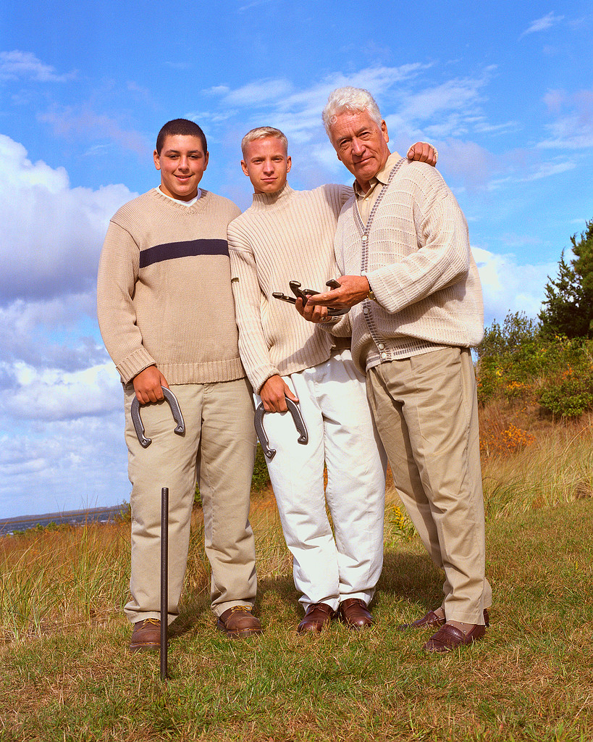
INTERGENERATIONAL VOLUNTEERING
This can be particularly beneficial to young people
Communication between people of very different ages often times is considered by both parties to be of special importance
Studies show contact fosters favorable images and attitudes of the younger towards older generations.
Likewise older generation often develop empathy for younger that didn’t exist before

Slide 11


Promotion
It is important to promote Intergenerational Programs for a variety of reasons:
  Define areas of social problems change
  Increase public knowledge about volunteering
  Garner community support for volunteering
  Secure future expansion/maintenance of volunteering

Slide 12

Importance
Intergenerational programs need sound planning but benefits are huge:
  Invoke powerful communication
  Develop social support dynamics
  Impact on the lives of participants
  Generate community improvements
  Establish a sense of cultural identity and continuity
*Intergenerational programs are a great way to meet the needs of the changing family

Slide 13

Conclusion:
The Need Far Outweighs the Supply!

